Slide 1

PROPERTIES OF THE DARKWEB
Tombini Nicolò - 10912627

Slide 2




TABLE OF CONTENTS
O
C
M
R
VERVIEW
ENTRALITIES
ESEOSCALE
OBUSTNESS
Network overview and its major properties
Network analysis based on centralities
Mesoscale network analysis: community detection, core-periphery
Link prediction and tolerance to random failures and attacks

Slide 3
—Wikipedia
“The dark web is the World Wide Web content that exists on darknets: overlay networks that use the Internet but require specific software, configurations, or authorization to access.”

Slide 4
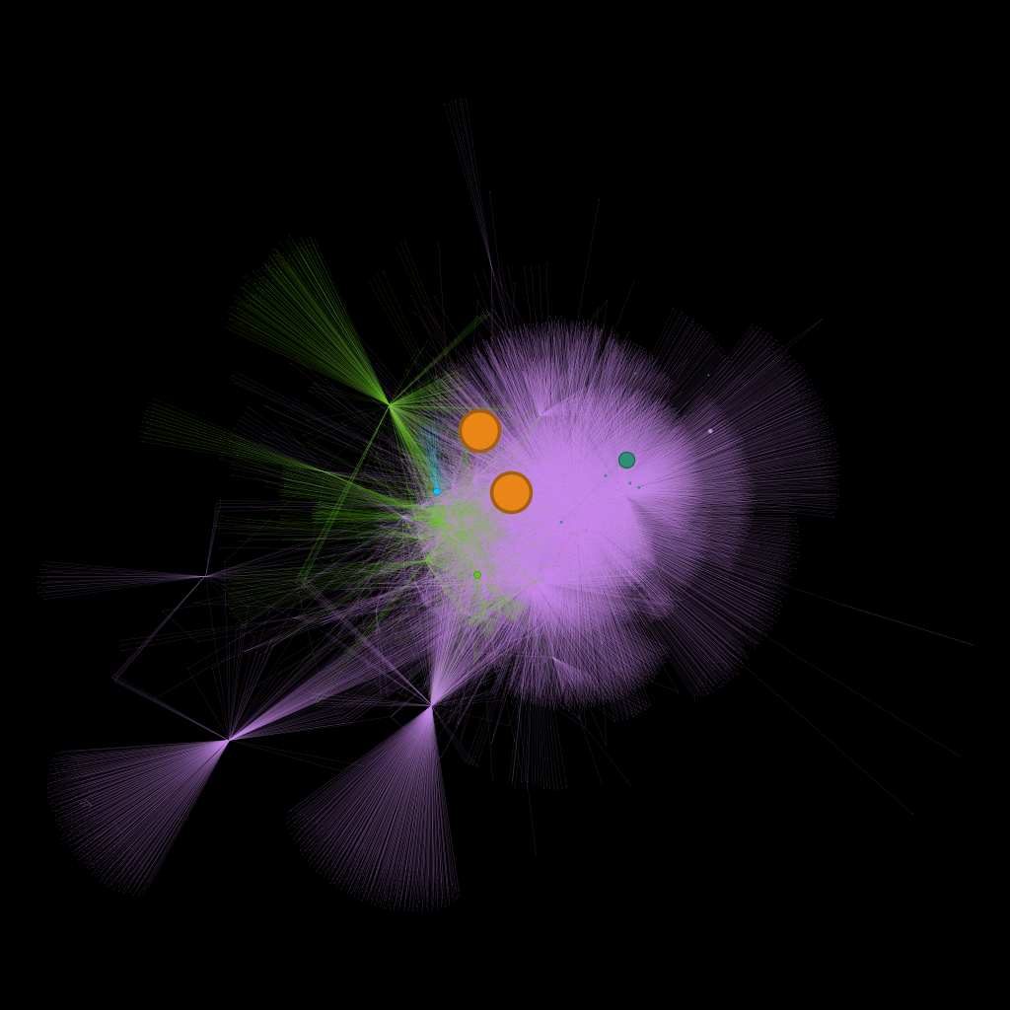
01
OVERVIEW
Network overview and its major properties

Slide 5
GENERAL CHARACTERISTICS
PROPERTY | VALUE
Nodes | 7178
Edges | 25104
Network Type | Directed, weighted
N° isolated nodes | 0
N° self loops | 0
N° WCC | 1
Largest WCC | 7178
N° SCC | 6820
Largest SCC | 297

Slide 6
NETWORK PROPERTIES
PROPERTY | VALUE
Average Distance | 4.35
Diameter | 10.0
Global Clustering Coefficient | 0.51
Average degree | 3.5
Average strength | 505.67
Efficiency | 0.011
Density | 0.00049
Assortativity coefficient | 0.087

Slide 7
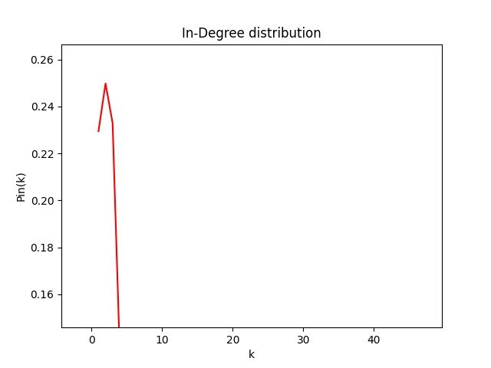
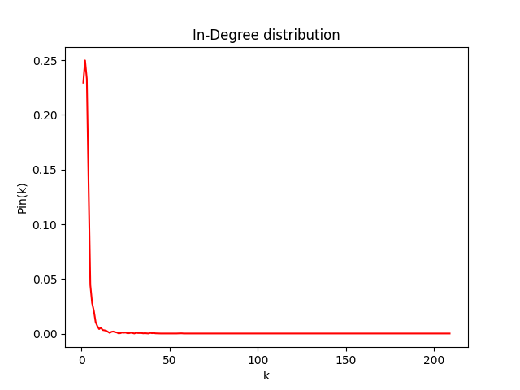
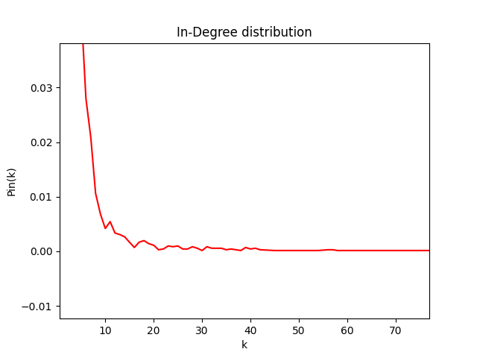
In-Degree Distribution

Slide 8
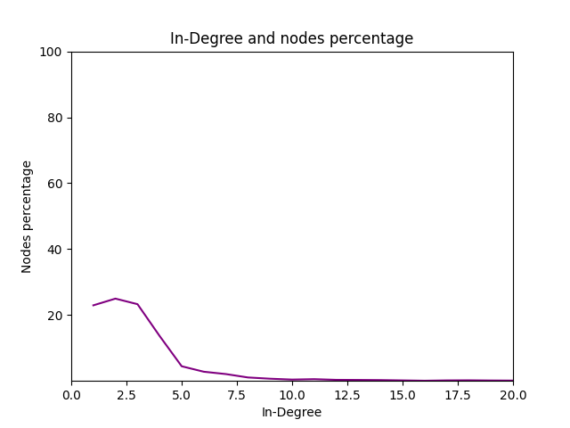
In-Degree nodes percentage
~30% of nodes (domains) have exactly one incoming link
Percentage of nodes with one incoming edge from out degree hubs = 78.2%

Slide 9
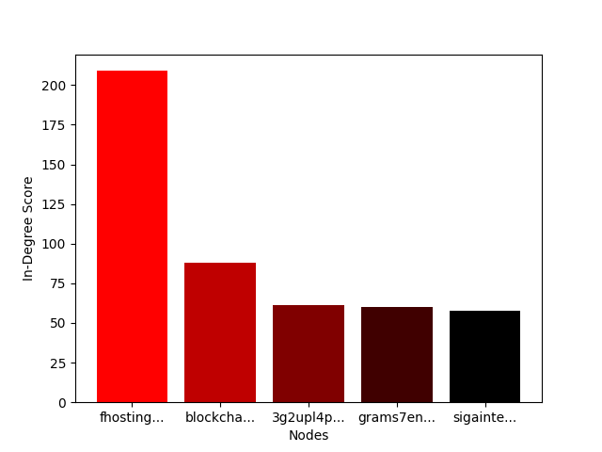
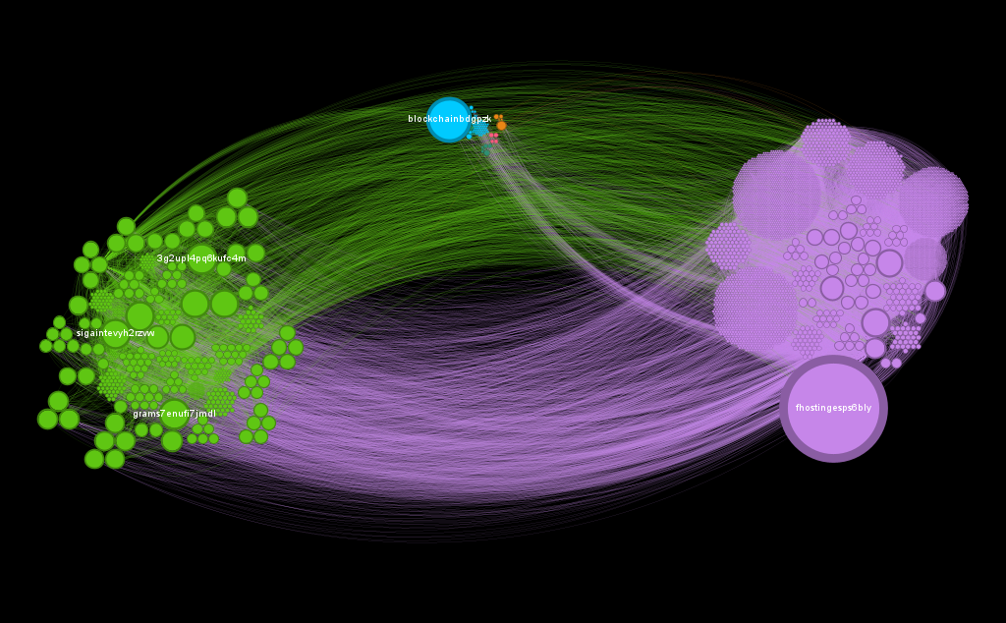
In-Degree Distribution on network

Slide 10
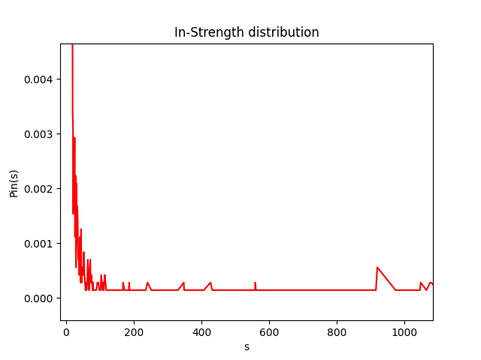
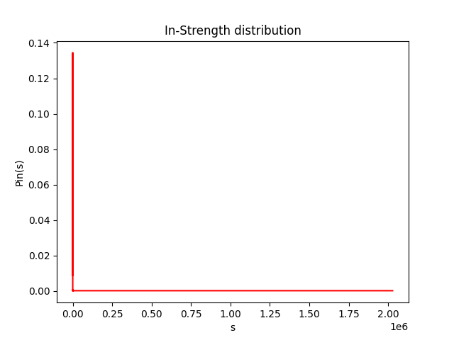
In-Strength Distribution

Slide 11
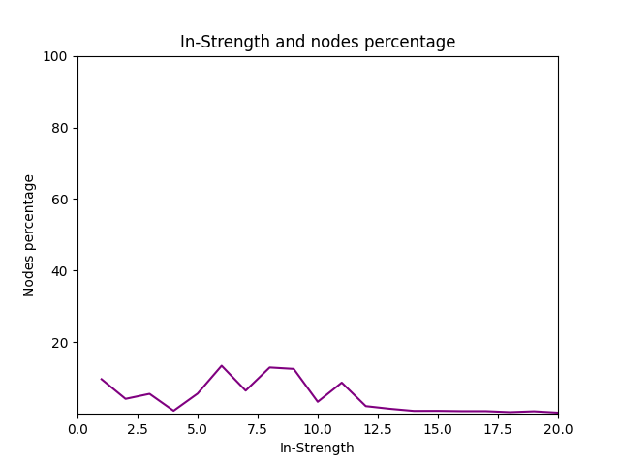
In-Strength nodes percentage
~10% of nodes (domains) have exactly one incoming link
OR
~42% of nodes (domains) having in-degree equal to 1

Slide 12
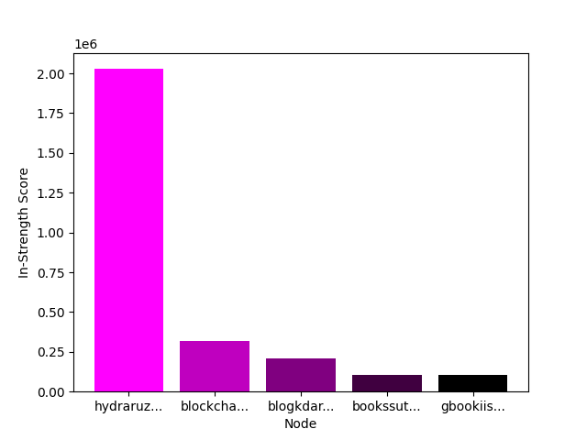
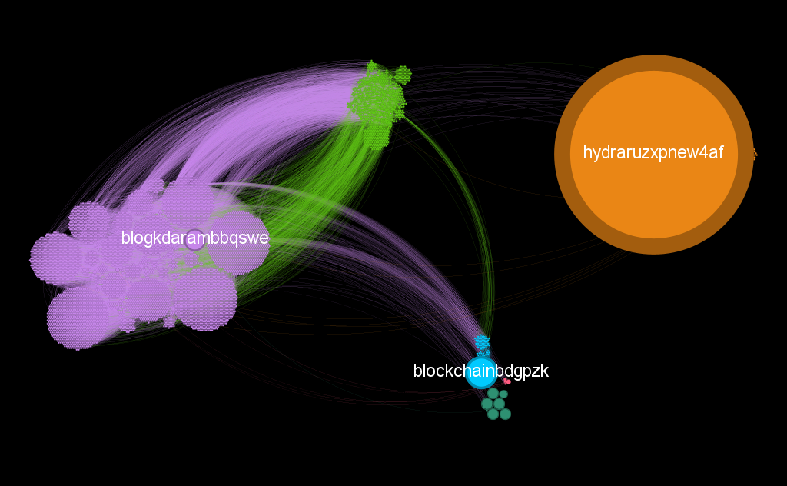
In-Strength Distribution on network

Slide 13
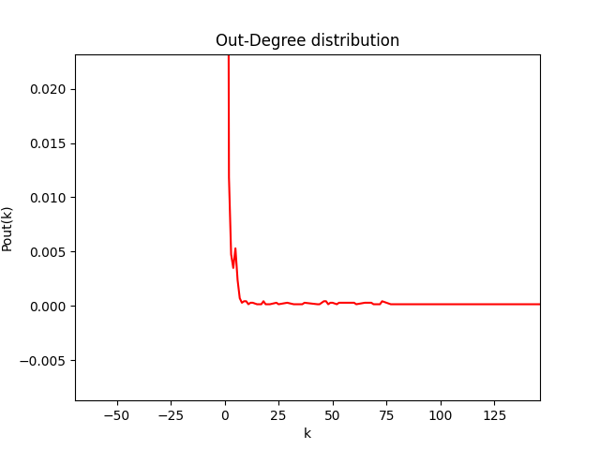
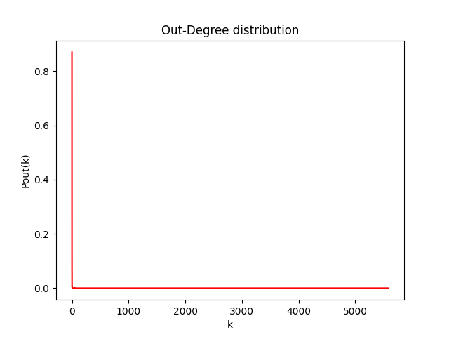
Out-Degree Distribution

Slide 14
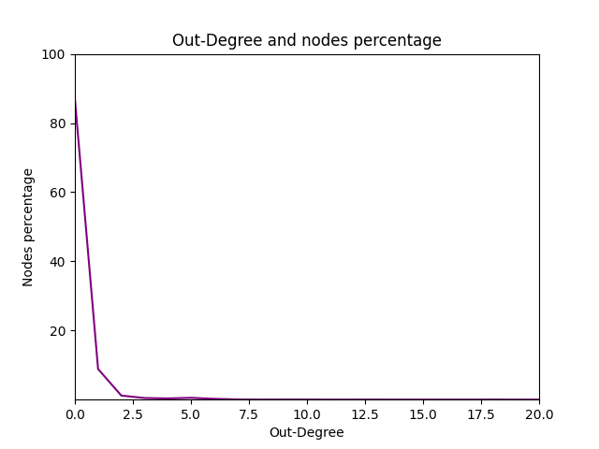
Out-Degree Distribution
~87% of nodes (domains) do not link to any other site

Slide 15
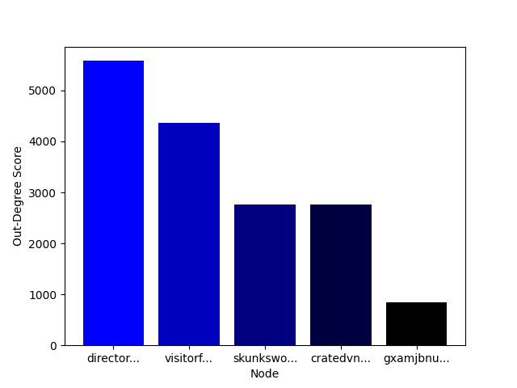
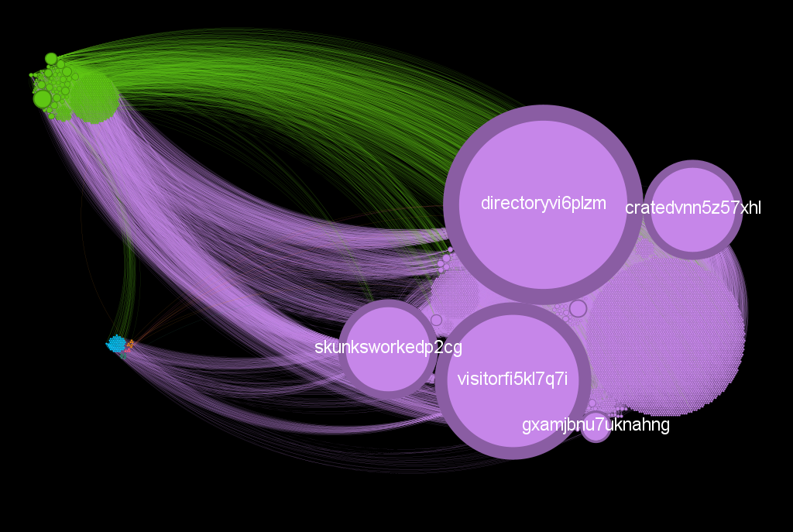
Out-Degree Distribution on network

Slide 16
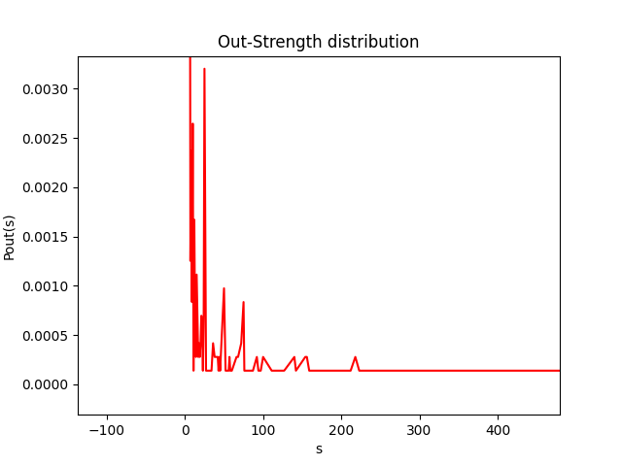
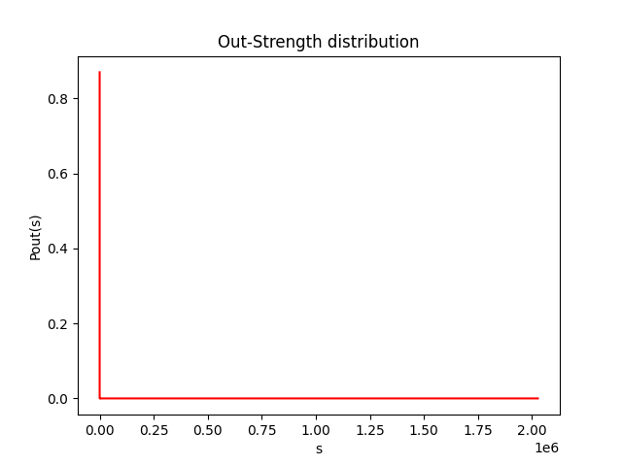
Out-Strength Distribution

Slide 17
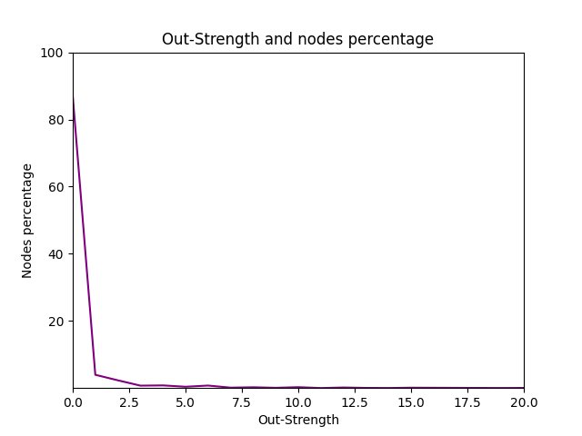
Out-Strength Distribution
~87% of nodes (domains) obviously have 0 out-strength because ~87% have 0 out-degree

Slide 18
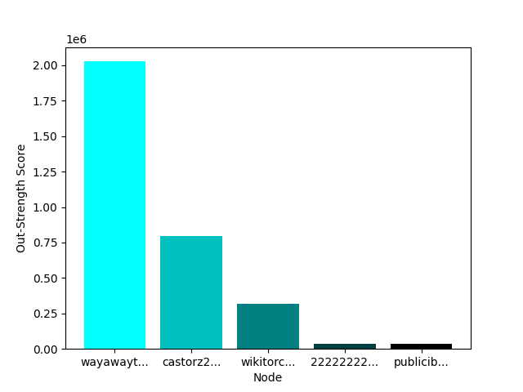
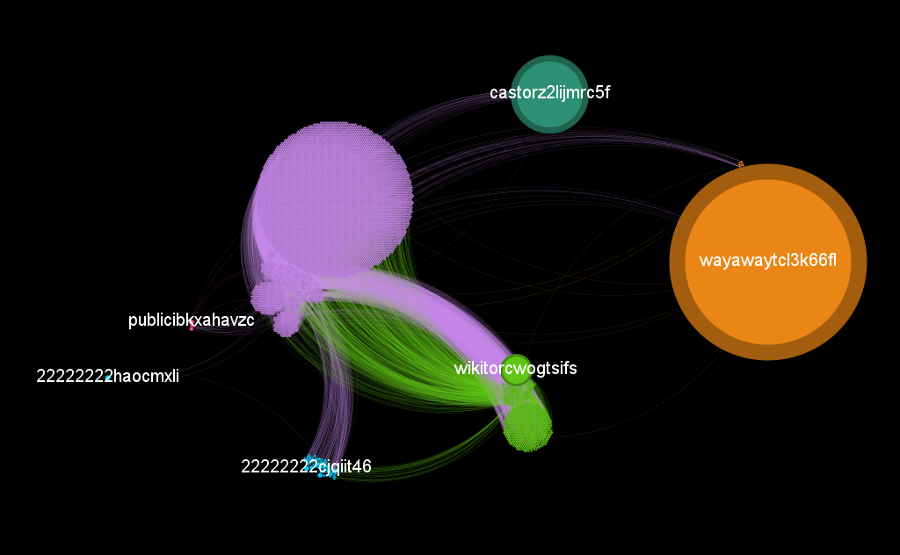
Out-Strength Distribution on network

Slide 19
02
NETWORK CENTRALITIES

Slide 20
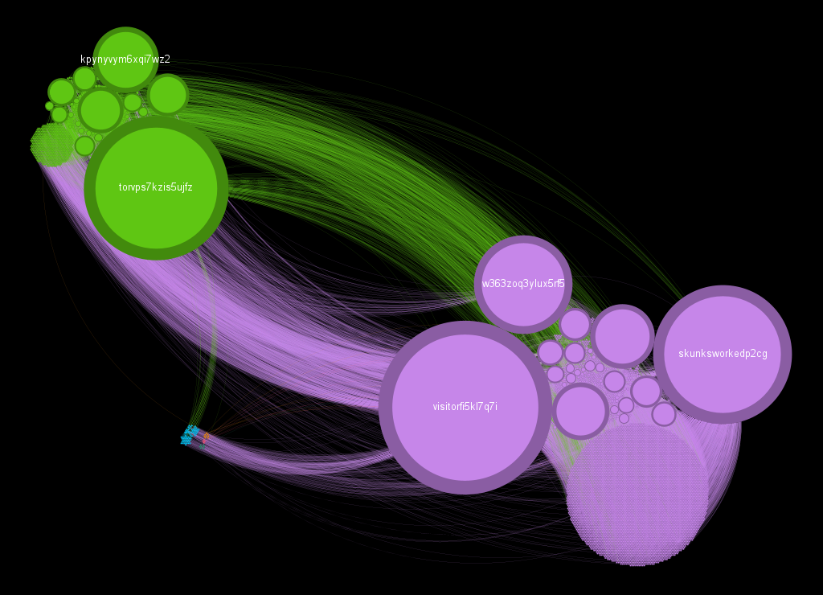
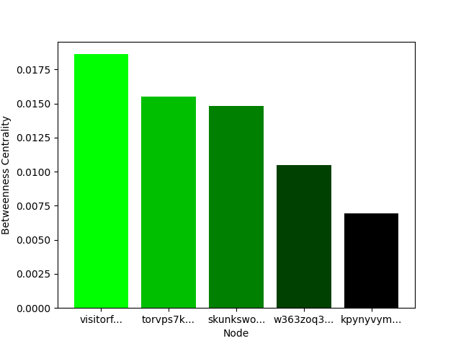
Betweenness Centrality
Put Your Screenshot
Here
No nodes weights considered

Slide 21
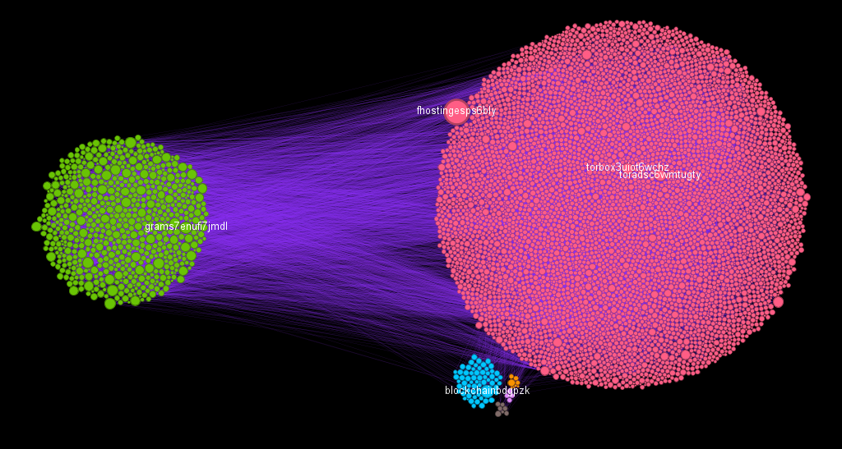
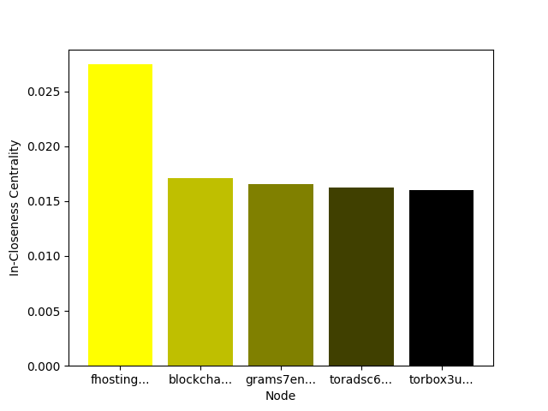
In-Closeness Centrality
Put Your Screenshot
Here
No nodes weights considered

Slide 22
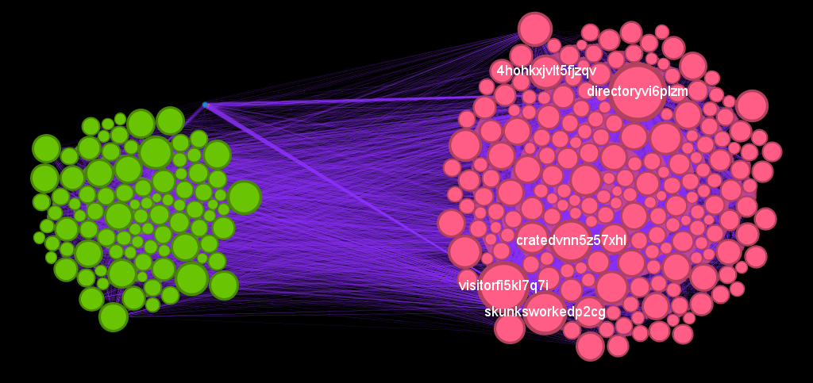
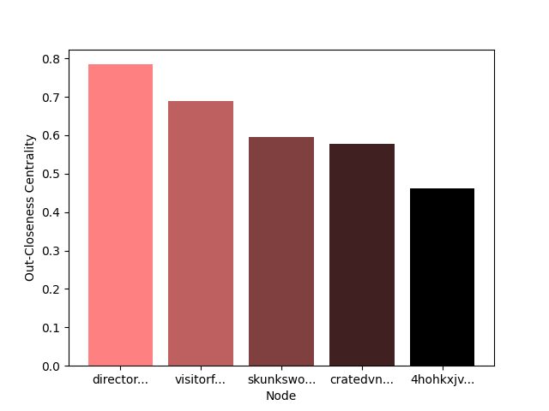
Out-Closeness Centrality
Put Your Screenshot
Here
No nodes weights considered

Slide 23
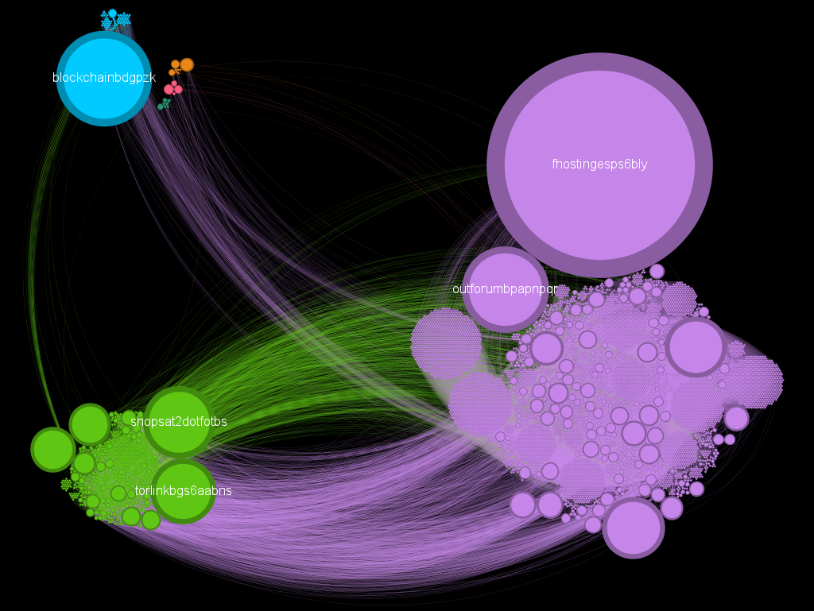
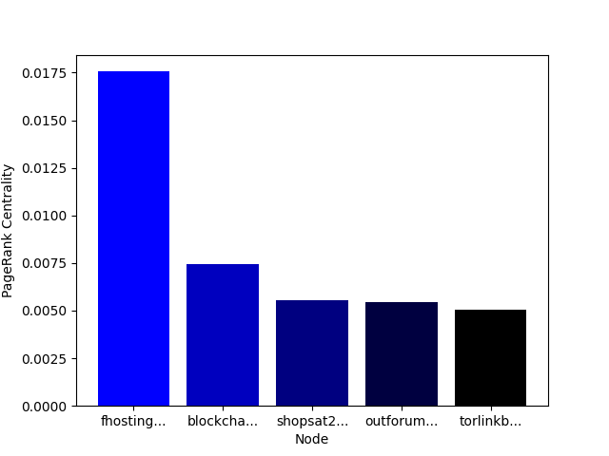
PageRank Centrality
Put Your Screenshot
Here

Slide 24
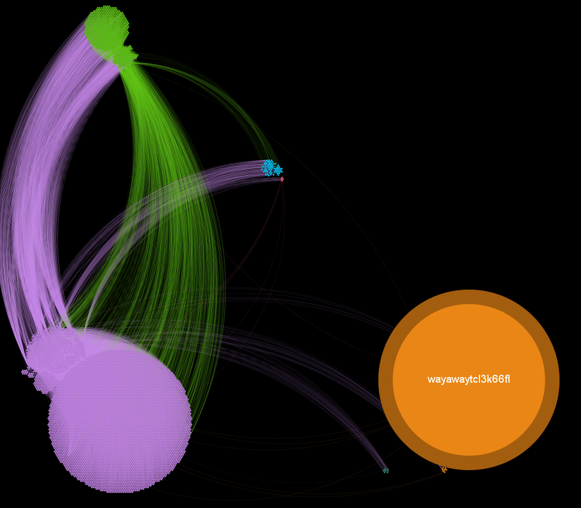
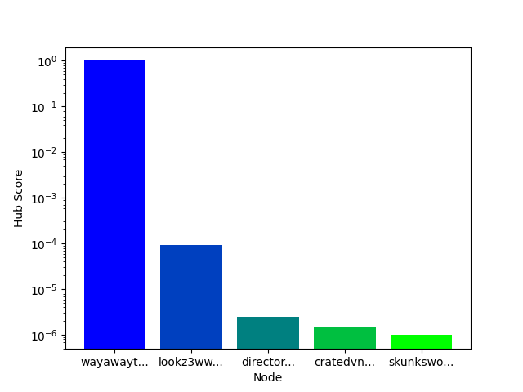
Hubs Score
Put Your Screenshot
Here

Slide 25
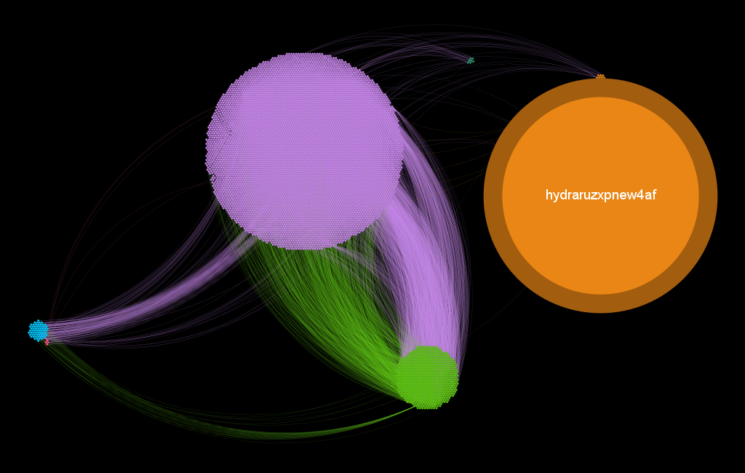
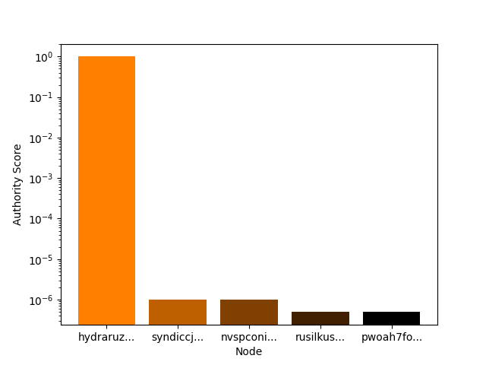
Authority Score
Put Your Screenshot
Here

Slide 26
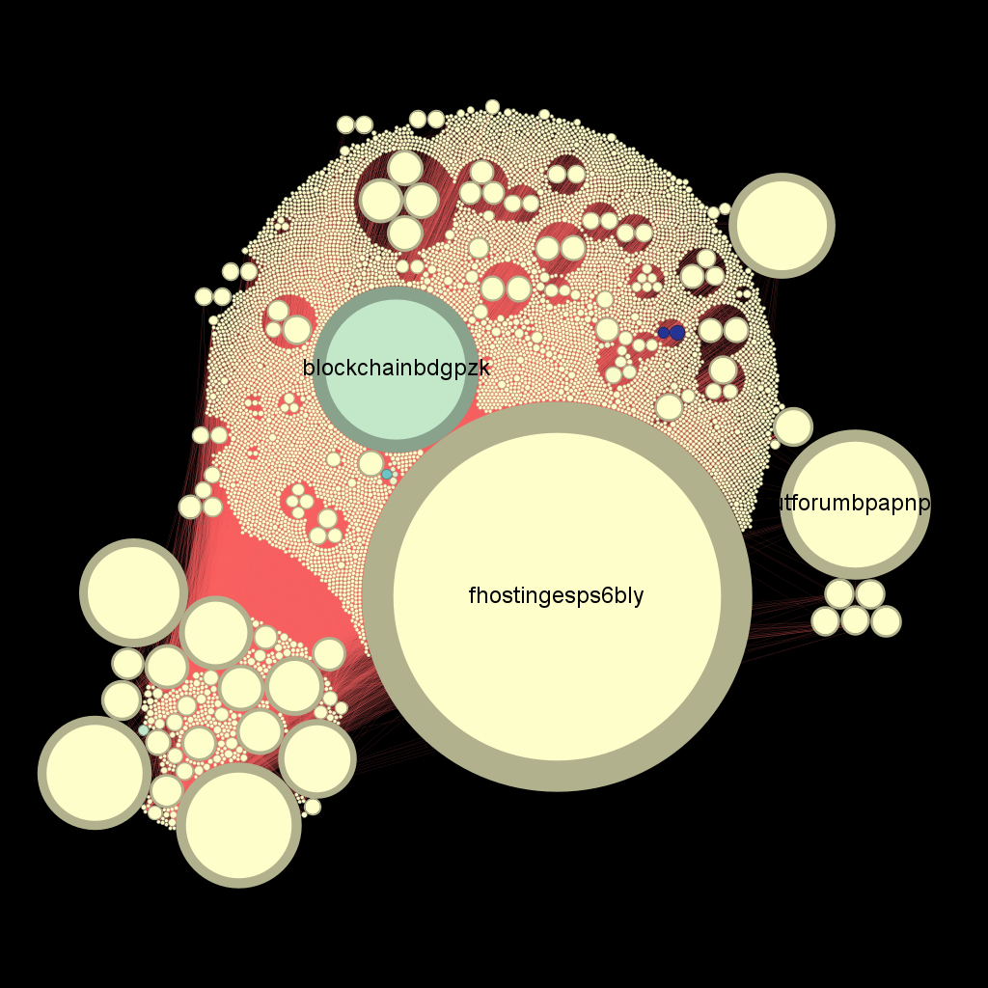
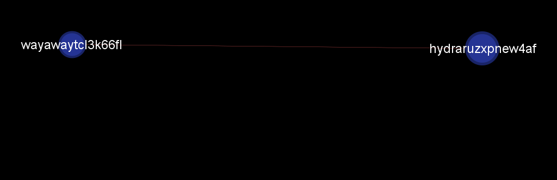
Analyze anomalies…
Out-Strength vs PageRank
Out-Strength ordered by color
PageRank ordered by dimension

Slide 27
03
MESOSCALE NETWORK ANALYSIS

Slide 28
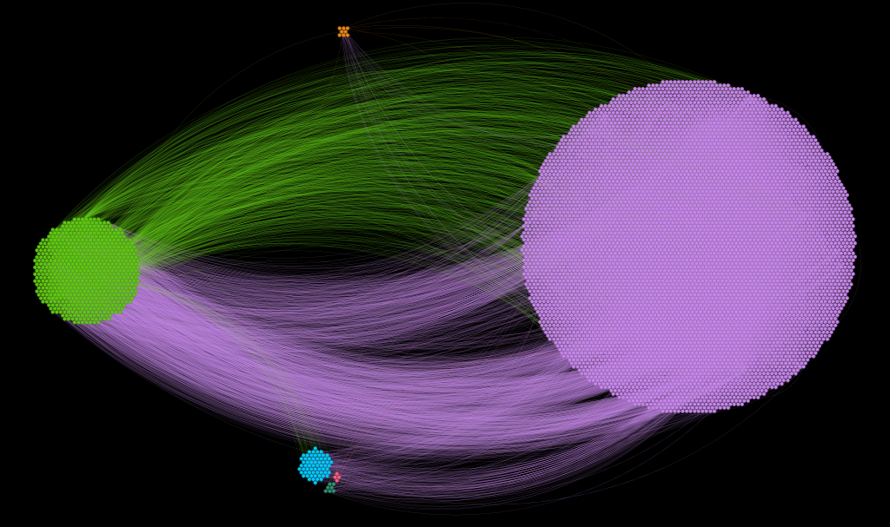
Community analysis - 1
Louvain Algorithm
Whole network considered
6 communities on average
Q = 0.582

Slide 29
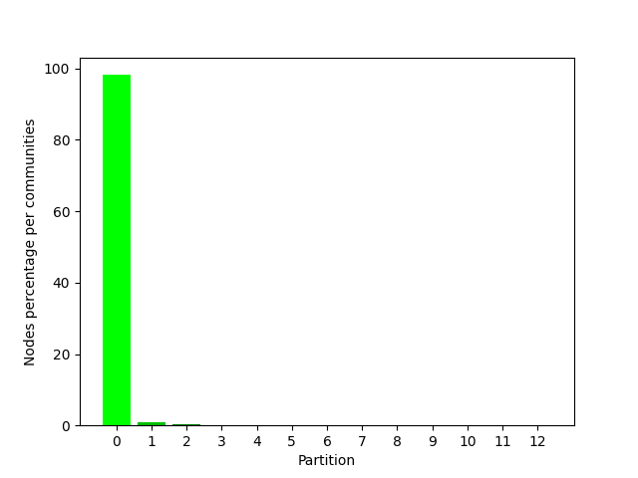
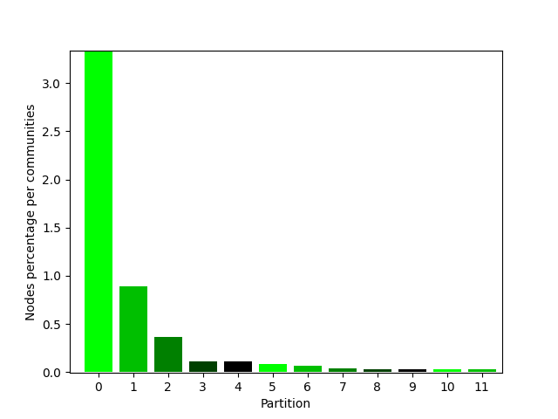
Community analysis - 2
Greedy Algorithm
Whole network considered
12 communities on average
Q = 0.618

Slide 30
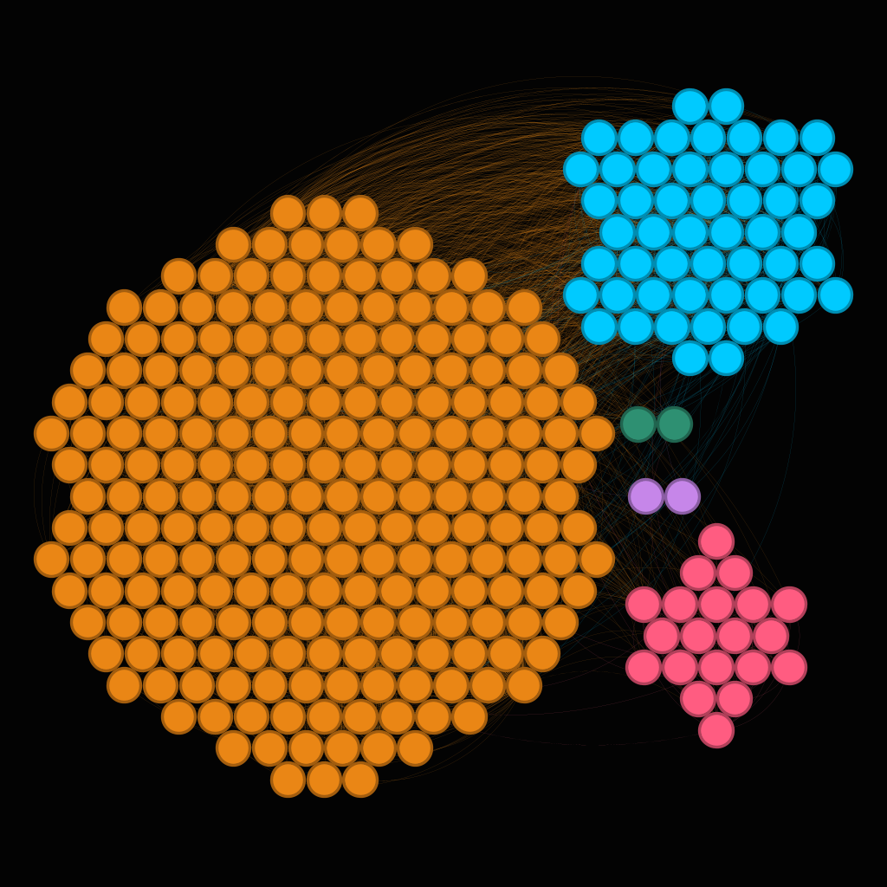
𝛼-Communities & 𝛼-Partitions - 1
Only SCC considered
Composed by 297 nodes
Directed and weighted
Louvain algorithm
5 communities on average
Q = 0.277

Slide 31
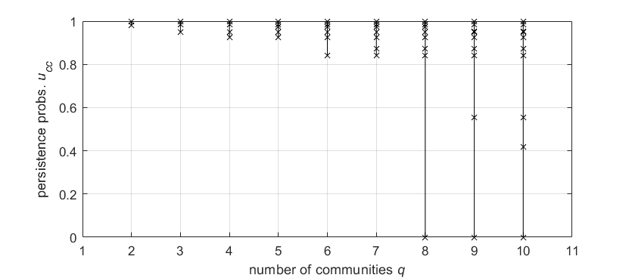
𝛼-Communities & 𝛼-Partitions - 2
Quality level 𝛼 = 0.8
Instead of Louvain we identify q = 7 community

Slide 32
𝛼-Communities & 𝛼-Partitions - 3
U₁₁ | U₂₂ | U₃₃ | U₄₄ | U₅₅ | U₆₆ | U₇₇
0.99 | 0.98 | --- | --- | --- | --- | ---
0.98 | 0.94 | 0.99 | --- | --- | --- | ---
0.92 | 0.99 | 0.98 | 0.94 | --- | --- | ---
0.99 | 0.97 | 0.92 | 0.98 | 0.94 | --- | ---
0.84 | 0.97 | 0.99 | 0.92 | 0.98 | 0.94 | ---
0.87 | 0.99 | 0.84 | 0.97 | 0.92 | 0.98 | 0.94
VALUE
RARE
IMITABLE
ORGANIZE
q =2
q = 3
q = 4
q = 5
q = 6
q = 7
Q = 0.30

Slide 33
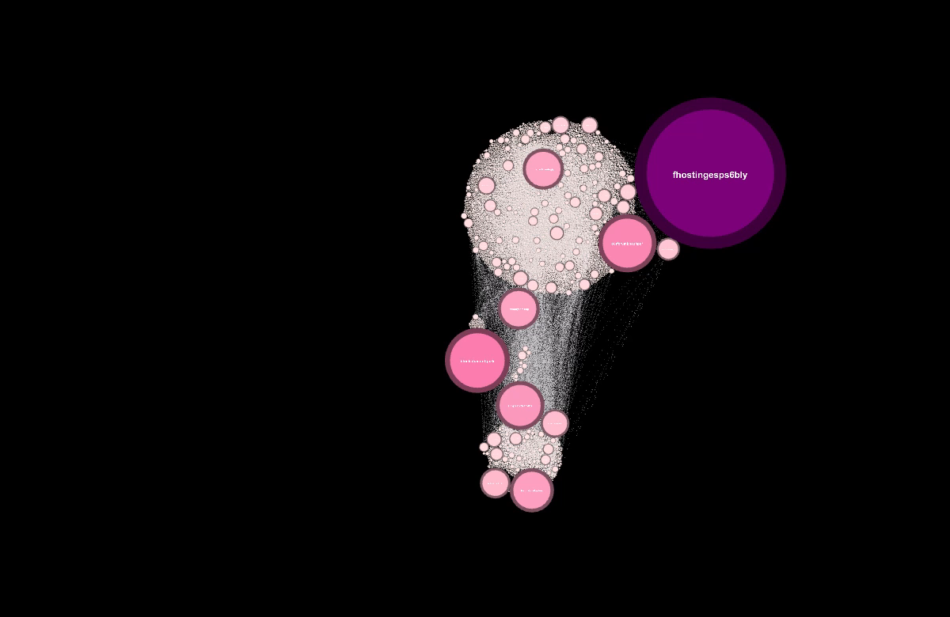
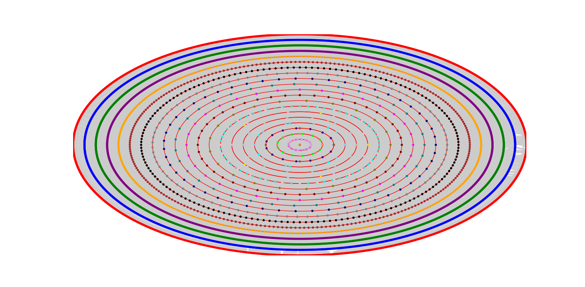
K-core decomposition
The whole network reaches k = 28

Slide 34
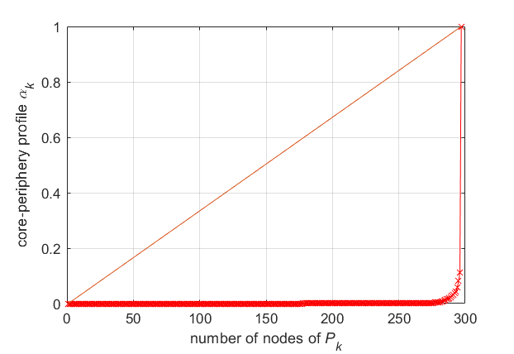
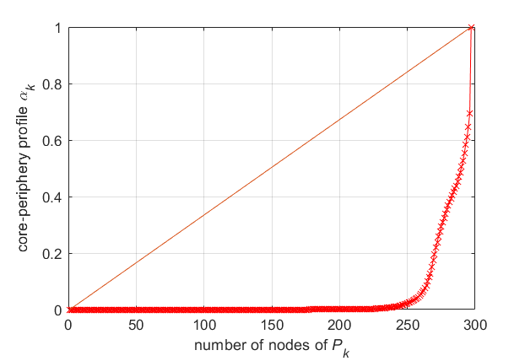
Core-Periphery profile
Always on SCC
Network directed
Weighted network considered
Star-like with weights
Unweighted network considered
Less star-like

Slide 35
04
ROBUSTNESS & LINK PREDICTION

Slide 36
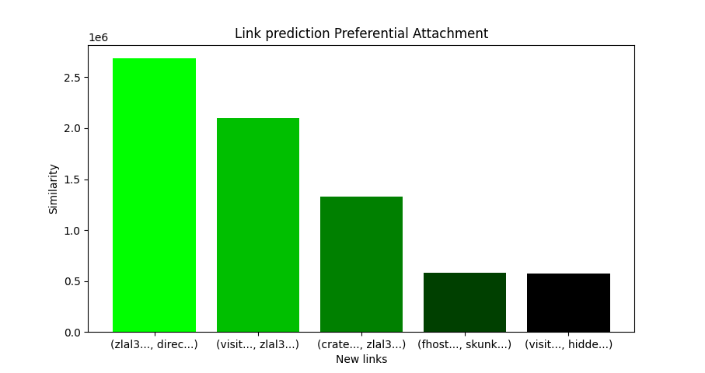
Link prediction – Preferential Attachment
Conversion from directed to undirected network
Whole network considered

Slide 37
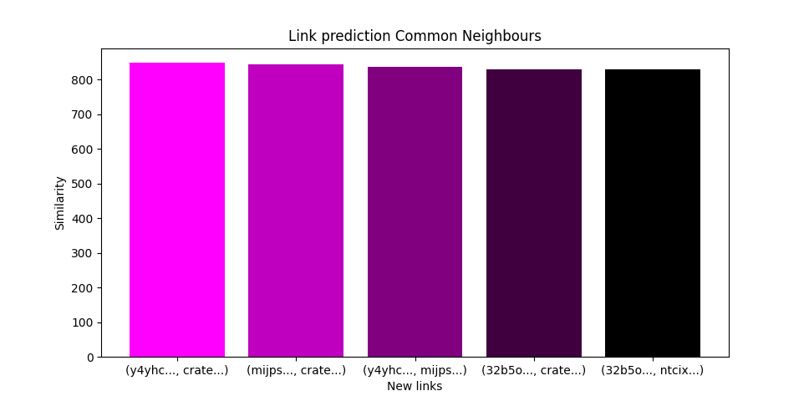
Link prediction – Common Neighbours
Conversion from directed to undirected network
Whole network considered

Slide 38
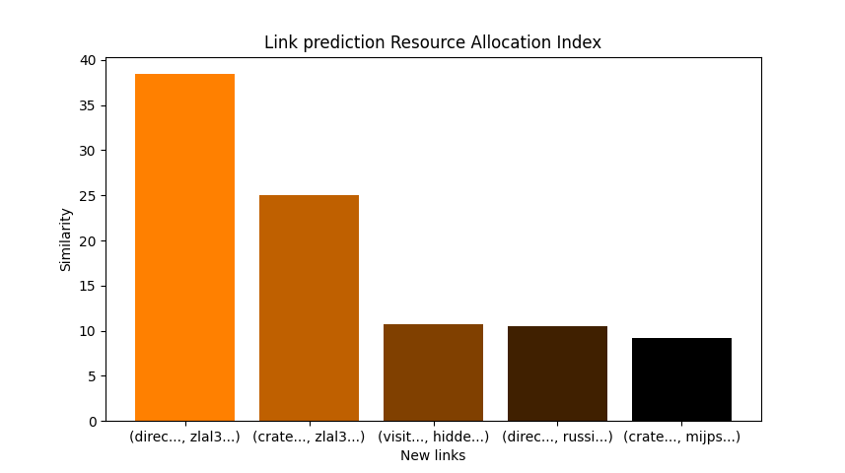
Link prediction – Resource Allocation Index
Conversion from directed to undirected network
Whole network considered

Slide 39
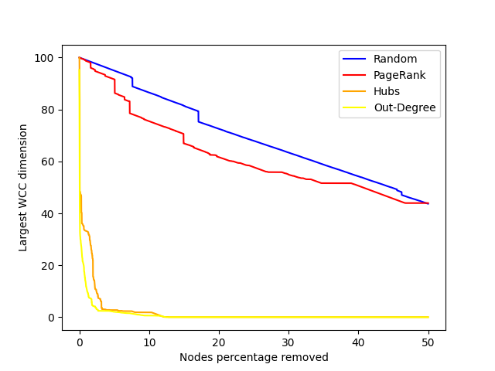
Robustness - 1
Whole network considered
Size of the largest connected component

Slide 40
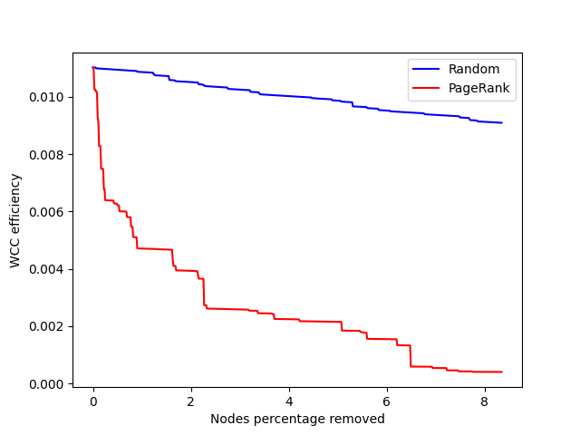
Robustness - 2
Whole network considered
Value of efficiency

Slide 41
05
Deeper Analysis

Slide 42

Darkweb VS World-Wide-Web - 1
Only Out and Core component
Network with extraordinarily low out-degrees

Slide 43



Darkweb VS World-Wide-Web - 2
WWW network
SPL = 4.27
Whole Darkweb network
SPL = 4.35
SCC darkweb network
SPL = 3.97
Proof that Darkweb of how sparse darkweb is
SCC SPL is only 9% less than the entire darkweb
SCC no densely interconnected

Slide 44



Used technologies
Numerical analysis
Graphical analysis
Persistance probabilities
Core-Periphery Analysis
Numerical analysis
Various algorithms

Slide 45
THANKS FOR YOUR ATTENTION!
Tombini Nicolò - 10912627

